Slide 1

SOUTHEASTERN STATES AUDIT CONFERENCE

Slide 2
Purpose
The Department shall have as its functions and purposes the systematic planning, construction, maintenance, and operation of the state highway system and the development of a statewide intermodal and freight system that is consistent with the needs and desires of the public.
SC Code of Laws 57-1-20
Notes:
Purpose of the Agency

Slide 3


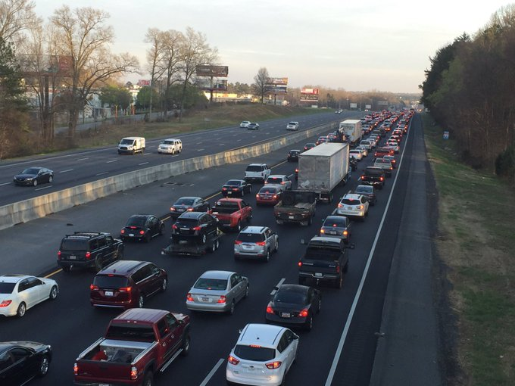
4th largest state highway system in the Nation
10th fastest population growth rate
in the Nation
Notes:
Our responsibility is to maintain 41,300 miles of road and more than 8,400 bridges across the state. SCDOT employs 4,500 hard working women and men. SCDOT Headquarters is located centrally in downtown Columbia with county offices in every county across the state.

Slide 4
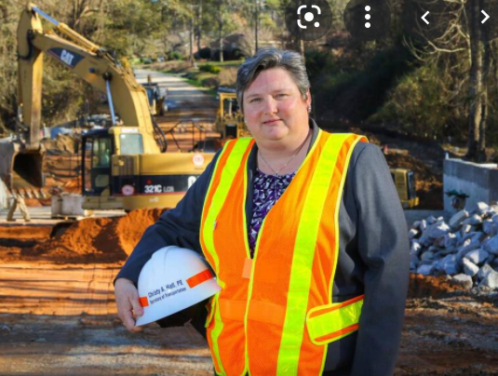
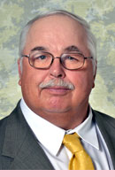
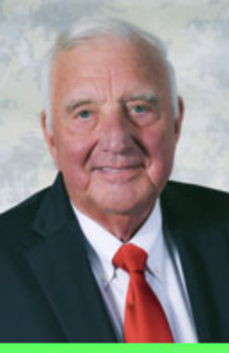
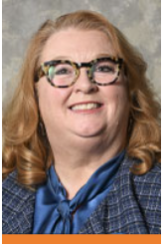
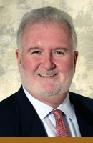
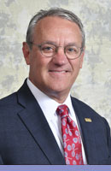
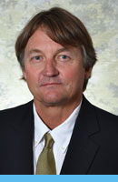
SCDOT Commission
Secretary of Transportation
Christy Hall
Currently there are three vacancies.
Notes:
The Commission is the administrative and governing authority of SCDOT. It is composed of nine members: one member from each Congressional District and two at-large members. The District members are appointed by the Governor, subject to approval of the legislative delegations of their respective Districts. The at-large members are appointed by the Governor, subject to approval by a separate confirmation vote in both the Senate and the House of Representatives. The Commission is responsible appointing the Secretary of Transportation which is Christy Hall.

Slide 5
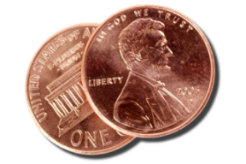
July 1, 2022 marked the final year of the phased-in 12¢ Gas Tax Increase
38.00¢
28.00¢
Now
1¢ generates ≈ $36 Million
32.20¢
Notes:
We are in the 5th year of the phased-in gas tax which will ultimately generate an additional 400 million in revenue per year

Slide 6
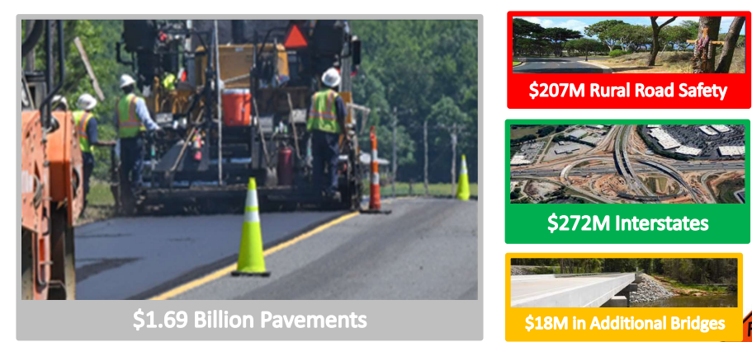
The New Gas Tax Trust Fund is Invested in:
As of December 31, 2021
Construction Contracts
2008
2014
2021
Notes:
New gas tax fund is dedicated to 4 main target areas including: Pavement, Rural Road Safety, Interstate Widening, and Bridge Replacements.

Slide 7
SCDOT has Dramatically Increased its Work Program
$3.8B
3x
$1B
Construction Contracts
2008
2014
2022
Notes:
Let’s talk orange cones.
We have put the money to work.
We have tripled our construction program over the past couple of years to a record-breaking $3.3B level today. The transportation industry has responded by also completing more work year over year to also record breaking levels today (approx. $1.7B completed annually now vs approx. $500M in previous years).

Slide 8
SCDOT Professional Services Increase
Construction Contracts
2008
2014
2022
Notes:
Let’s talk orange cones.
We have put the money to work.
We have tripled our construction program over the past couple of years to a record-breaking $3.3B level today. The transportation industry has responded by also completing more work year over year to also record breaking levels today (approx. $1.7B completed annually now vs approx. $500M in previous years).

Slide 9

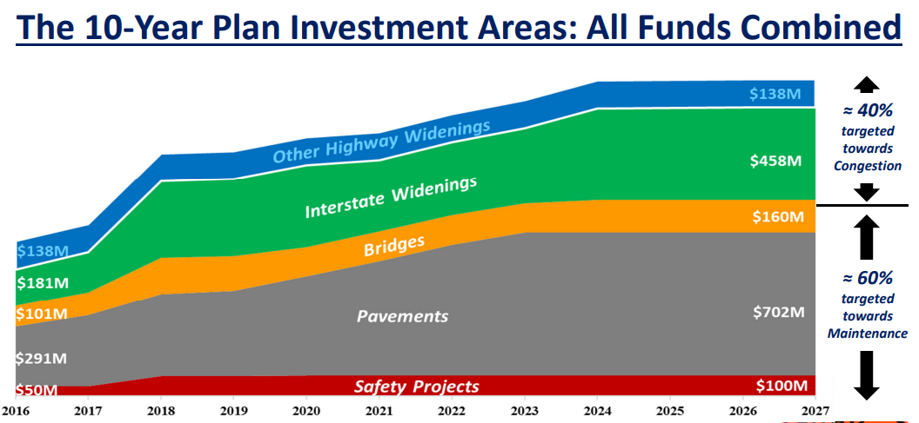
Notes:
This graph breaks down the percentage of investment in each of the targeted areas. The top line identifies non-interstate widening as a new targeted investment category moving into the future.

Slide 10
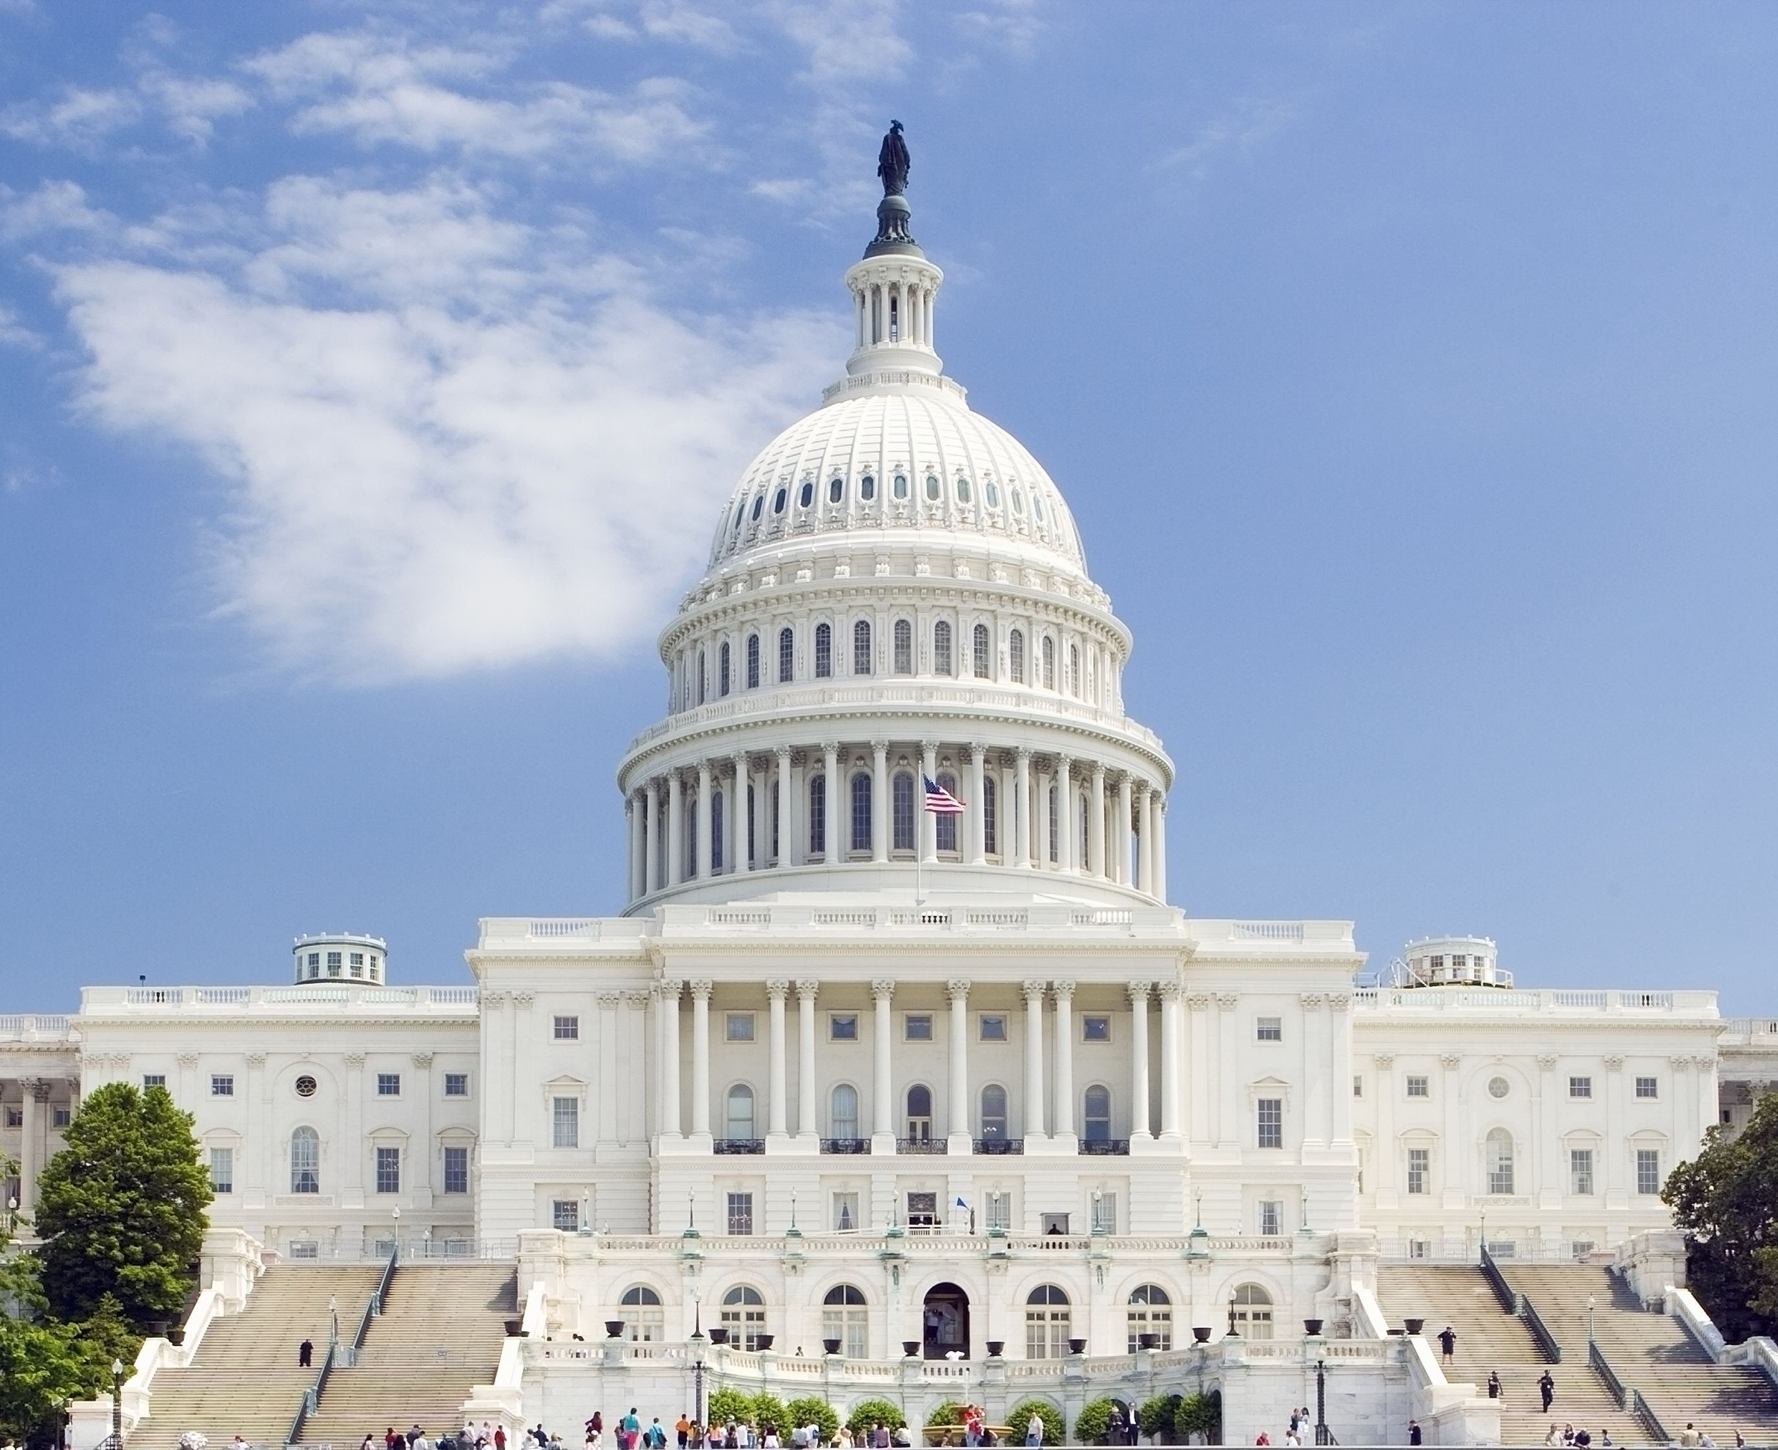
More Federal Funding is Coming to SCDOT
The Federal Surface Transportation Program grew by more than 30%.
$733M
≈$1 Billion
annually
Notes:
New Infrastructure Bill will grow the federal program to $1 Billion annually.

Slide 11

Professional Services Contracting Office

Slide 12
Professional Services Contracting Office
Nicholas Pizzuti, Chief Professional Services
Dorothy Moore, Admin Coordinator
Dale Wagoner, Small Purchase Program
Wendy Hollingsworth, Selection Manager
James Kimble, Contract Negotiator
Rose Martinez-Vazquez, Contract Negotiator
Emily Smith, Contract Negotiator
Darrin Player, Chief Procurement Officer

Slide 13
SCDOT PROCUREMENT PRACTICES
Two Tier Procurement Process
  Workload Capacity is used as a criterion based on risk of project. High Risk 5%, Medium Risk 10% or Low Risk 15%.
  Workload Capacity is based on team not just prime.
  The Professional Service Office inputs these scores after technical criteria have be entered and locked in.
Notes:
New Infrastructure Bill will grow the federal program to $1 Billion annually.

Slide 14
SCDOT PROCUREMENT PRACTICES
Fixed Fee
  SCDOT uses average overhead rate as a starting point for fixed fee negotiation.
  Produce fixed fees that are consistent for the same work.
  Generate fair, competitive and reasonable compensation to consultants, SCDOT and taxpayers of SC.
Notes:
New Infrastructure Bill will grow the federal program to $1 Billion annually.

Slide 15
SCDOT PROCUREMENT PRACTICES
Fixed Fee Calculation
  Fixed Fee= (DL+(DL*AvgOH))*FF Rate
  Total Combined Subtotal
  =(DL+(DL*OH))+((DL+(DL*AvgOH))*FF Rate)
Notes:
New Infrastructure Bill will grow the federal program to $1 Billion annually.

Slide 16
Round Table Discussion Topics
Lump Sum Contracts
Approval Process
Bridge Bundling
Two Step Procurement with Short Listing
Notes:
New Infrastructure Bill will grow the federal program to $1 Billion annually.

Slide 17

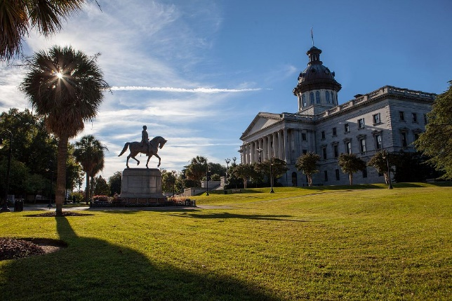



Southeastern States Audit and Procurement Conference 2023
South Carolina cordially invites you all to the 2023 conference. Please be on the lookout for further information.
Notes:
New Infrastructure Bill will grow the federal program to $1 Billion annually.

