Slide 1
BIPARTISAN INFRASTRUCTURE LAW (BIL)* Overview of Highway Provisions
Kadian Hollenquest
Alabama Division
October 23 - 26, 2022
*Also known as the “Infrastructure Investment and Jobs Act”

Slide 2
Setting the stage
Introductory Notes
Key Terms

Slide 3
Introductory Notes
This presentation:
focuses on highway provisions in the BIL
provides an overview of significant programs and provisions, but it is not all inclusive
does not include programs that BIL authorizes subject to future appropriation
includes information on several relevant programs that the Office of the Secretary will administer
Section (§) references in the presentation refer to BIL sections
References to “Division J” refer to the appropriations portion of BIL (Title VII relates to the U.S. Department of Transportation)
For more information, please visit the Federal Highway Administration’s BIL website: fhwa.dot.gov/bipartisan-infrastructure-law
Disclaimer: Except for any statutes or regulations cited, the contents of this presentation do not have the force and effect of law and are not meant to bind the public in any way. This presentation is intended only to provide information regarding existing requirements under the law or agency policies.

Slide 4
Key Terms
Budget Authority: authorization by Congress that allows Federal agencies to incur obligations that will result in the outlay of funds
Contract Authority (CA): form of Budget Authority that permits obligations to be made in advance of appropriations
Appropriated Budget Authority (ABA): Budget authority to incur obligations and to make payments from the Treasury for specified purposes
Advance Appropriations: appropriated funds that become available for obligation one or more fiscal years after the year for which the appropriation was enacted
Apportionment: the distribution of funds to States as prescribed by statutory formula
Allocation: an administrative distribution of funds for programs that are not distributed to States by statutory formula
Obligation: the Federal government’s legal commitment to pay or reimburse entities for the Federal share of a project’s eligible costs
Highway Trust Fund (HTF): account established by law to hold Federal highway-user taxes that are dedicated for highway and transit related purposes

Slide 5
BIL highlights
Milestones Toward Enactment of BIL
BIL Goes Beyond Transportation
Includes $567.1 B (All DOT Modes) Over FY 22-26
High Points of BIL Highway Provisions

Slide 6
Milestones Toward Enactment of BIL
Date | Milestone
July 2021 | Senators released bipartisan infrastructure framework
August 10, 2021 | Senate passed Bipartisan Infrastructure Deal (BIL)
November 5, 2021 | House passed BIL
November 15, 2021 | President Biden signed BIL into law (Public Law No: 117-58)

Slide 7
BIL Goes Beyond Transportation
Once-in-a-generation investment in infrastructure
Grows the economy, enhances U.S. competitiveness, creates good jobs, and makes the U.S. economy more sustainable, resilient, and equitable
Around $550 B in new Federal infrastructure investment, including—
Largest federal investment in public transit ever
Largest federal investment in passenger rail since the creation of Amtrak
Largest dedicated bridge investment since the construction of the Interstate System
Largest investment in clean drinking water & wastewater infrastructure in U.S. history
Largest investment in clean energy transmission & electric vehicle infrastructure in history
Ensuring every American has access to reliable high-speed internet
On average, around 2 million jobs per year

Slide 8
Includes $567.1 B (All DOT Modes) Over FY 22-26
Program | Contract Authority (CA) ($ B, FY 22-26) | Advance appropriations ($ B, FY 22-26)
Federal Aviation Administration | --- | 25.0
Federal Highway Administration | 303.5 | 47.3
Federal Motor Carrier Safety Administration | 4.5 | 0.7
Federal Railroad Administration / Amtrak | --- | 66.0
Federal Transit Administration | 69.9 | 21.3
Maritime Administration | --- | 2.3
National Highway Traffic Safety Administration | 5.1 | 1.6
Office of the Secretary | --- | 19.0
Pipeline & Hazardous Materials Safety Admin. | --- | 1.0
Total | 383.0 | 184.1
Note: Table does not include amounts that BIL authorizes but are subject to [future] appropriation

Slide 9
High Points of BIL Highway Provisions
Funds highway programs for five years (FY 22-26)
$350.8 B (FY 22-26) for highway programs
$303.5 B in Contract Authority (CA) from the Highway Trust Fund (HTF)
+$47.3 B in advance appropriations from the General Fund (GF)
More than a dozen new highway programs, including─
Formula: resilience, carbon reduction, bridges and electric vehicle (EV) charging infrastructure
Discretionary: bridges, EV charging infrastructure, rural projects, resilience, wildlife crossings, and reconnecting communities
Focus on safety, bridges, climate change, resilience, and project delivery
More opportunities for local governments and other non-traditional entities to access new funding
$90 B transfer (GF->HTF) to keep the HTF Highway Account solvent for years

Slide 10
$350.8 B (FY 22-26) for Highway programs
$303.5 B in Contract Authority from the HTF
+$47.3 B from the General Fund (GF) for “Highway Infrastructure Programs” (HIP)
Nine Categories of HIP Funding Under BIL (from the GF)
Funding Available to a Range of Recipients

Slide 11
$303.5 B in Contract Authority from the HTF
Five years of funding (FY 22-26)
+29% highway CA (avg. annual, FY 22-26) vs. current law (FY 21)
Mostly (90%) apportioned to States
All FAST Act highway programs will continue
…plus, new CA programs (apportioned and allocated)
BIL highway CA, apportioned vs. allocated
90% apportioned (formula)
10% allocated

Slide 12
+$47.3 B from the General Fund (GF) for “Highway Infrastructure Programs” (HIP)
BIL HIP advance appropriations, formula vs. discretionary
Majority (72%) distributed by formula
All provided from the General Fund
9 categories of advance appropriations; 6 supplemental to CA
28% discretionary
72% formula

Slide 13
Nine Categories of HIP Funding Under BIL (from the GF)
Total, FY 22-26 | Program
$27.5 B | Bridge Formula Program
$9.2 B* | Bridge Investment Program (discretionary)
$5.0 B | National Electric Vehicle Formula Program
$3.2 B* | INFRA Program
$1.3 B | Appalachian Development Highway System (ADHS)
$0.5 B* | Reconnecting Communities Pilot Program
$0.3 B* | Ferry Boat Program
$0.2 B* | Reduction of Truck Emissions at Port Facilities
$0.1 B* | University Transportation Centers (UTCs)
* Supplements CA separately provided by BIL for this program

Slide 14
Funding Available to a Range of Recipients
Program Examples | State | PR* | MPO | Local | Tribe | PA** | Territory | FLMA**
Apportioned programs (formula) | ✓ | *
Bridge Program (formula) | ✓ | ✓ |  |  | ✓
National Electric Vehicle Formula Program | ✓ | ✓ |  | ✓
Safe Streets and Roads for All program |  |  | ✓ | ✓ | ✓
PROTECT Grants (discretionary) | ✓ | ✓ | ✓ | ✓ | ✓ | ✓ | ✓*** | ✓***
Charging and Fueling Infrastructure Program | ✓ | ✓ | ✓ | ✓ | ✓ | ✓ | ✓
Congestion Relief Program | ✓ | ✓ | ✓ | ✓
Bridge Investment Program (discretionary) | ✓ | ✓ | ✓*** | ✓ | ✓ | ✓ |  | ✓
Reconnecting Communities Pilot Program | ✓ | ✓ | ✓ | ✓ | ✓
Rural Surface Transportation Grants | ✓ | ✓ |  | ✓ | ✓
INFRA | ✓ | ✓ | ✓*** | ✓ | ✓ | ✓ |  | ✓
National Infrastructure Project Assistance | ✓ | ✓ | ✓ | ✓ | ✓ | ✓ | ✓
Local and Regional Project Assistance | ✓ | ✓ | ✓ | ✓ | ✓ | ✓ | ✓
Natl. Significant Fed. Lands & Tribal Projects | ✓*** | ✓*** | ✓*** | ✓*** | ✓ | ✓*** |  | ✓
Tribal Transportation Program Safety Fund |  |  |  |  | ✓
Note: This table does not include all BIL programs or eligible entities, and there are additional nuances not represented in this table. Additional programmatic information is provided in later slides. FHWA will administer most, but not all, programs listed.
* PR = Puerto Rico, has funding allocated from 23 USC 165(b)(2)(C). Of that funding, least 50% is for purposes eligible under NHPP and 25% under HSIP, and the remainder is for other activities eligible under chapter 1 of title 23.
** PA = a special purpose district or public authority with a transportation function; FLMA = Federal Land Management Agency
*** May be eligible if partnered with an eligible entity, or under other specific conditions. For example, territories can apply for PROTECT at-risk coastal infrastructure grants [23 USC 176(d)(4)(C)]. See program information sources for more details.

Slide 15
Changes to current Program
Federal Lands Transportation Program (FLTP)
Federal Land Access Program FLAP
Tribal Transportation Program (TTP)
Nationally Significant Federal Lands & Tribal Projects Program (NSFLTP)
INFRA Program (discretionary)
Freight Provisions
Notes:
FLTP-
Raises (from $10M to $20M) the annual cap on FLTP funds that may be used in support of environmental mitigation to improve public safety and reduce vehicle-caused wildlife mortality while maintaining habitat connectivity
Requires that ≥$7M be made available each FY for each Federal agency eligible to compete for amounts made available for the program (Division J)
Increases the amount of FLTP and FLAP funds to be set aside each FY for transportation planning from 5% to 20% (§11113)
Requires FLTP projects to consider, to the maximum extent practicable, the use of locally adapted native plants and designs that minimize runoff and heat generation
FLAP
Adds new eligibility for context-sensitive solutions, interpretive panels in or adjacent to parking areas, wayfinding markers, landscaping, and cooperative mitigation of visual blight
Changes the Federal share to up to 100% (as opposed to being determined based on 23 U.S.C. 120)
Increases the amount of FLAP and FLTP funds to be set aside each FY for transportation planning from 5% to 20%
Requires FLAP projects to consider, to the maximum extent practicable, use of locally adapted native plants and designs that minimize runoff and heat generation
TTP
Eliminates current TTP set‐aside for Tribal Transportation Bridge Program
Sets aside from the TTP $45 M (FY 22-26) in Contract Authority from HTF to fund Tribal High Priority Projects program (§11128)
Increases set‐aside amount for TTP Safety Fund from 2% to 4% (§14008)
Updates bridge terminology, replacing references to “deficient bridges” and “structurally deficient or functionally obsolete” with “classified as in poor condition, having low load capacity, or needing geometric improvements” (§11524)
NSFLTP
Reduces (from $25 M to $12.5 M) minimum eligible project cost
Modifies the Federal share:
Establishes a Federal share for Tribal projects of 100%;
For other projects, it allows title 23 and title 49 funds to be used for the “non‐Federal” share
Requires an even split between Tribal and Federal lands projects
Of the funds for Federal lands projects, requires that at least 1 eligible project be carried out in a unit of the National Park System with ≥3 M annual visitors
INFRA
Adds eligibility for:
A highway, bridge, or freight project on the National Multimodal Freight Network
Marine highway corridor projects functionally connected to NHFN and likely to reduce on-road emissions;
Wildlife crossing projects; and
Surface transportation projects within the boundaries of or functionally connected to an international border crossing area;
Increases flexibility to use INFRA funds (up to 30% per FY) on non-highway freight projects
Sets aside ≥15% (instead of 10%) of grant funding for small projects and at least 30% of the set-aside amount for projects in rural areas
Freight Provision
Office of Multimodal Freight Infrastructure and Policy
(§21101)
Establishes an office in OST to carry out a national multimodal freight policy and related activities
Led by new Assistant Secretary for Multimodal Freight
Secretary may consolidate any DOT office/function within new OST office
Will administer INFRA, Local and Regional Project Assistance Program (RAISE), and new discretionary grant programs
National Freight Strategic Plan
(§21102)
Adds new elements related to impacts of freight movement on environment and rural, underserved and historically disadvantaged communities, resilience, decarbonization, and economic growth
State freight plans
(§21104)
Requires State freight plans to include several new requirements in categories such as adequacy of commercial motor vehicle parking and rest facilities, supply chain cargo flows, inventory or commercial ports, impacts of e-commerce, and strategies and goals to address impacts of freight movement on the environment
State freight advisory committees
(§21107)
Expands the list of organizational perspectives to be represented on a state freight advisory committee
establishes qualifications for advisory committee members

Slide 16
Changes to Emergency Relief Program (ER)
§11106
Topic | Changes
Eligibilities | Adds wildfire to list of natural disasters for which ER funding is authorized Permits ER projects to incorporate economically justifiable improvements that will mitigate the risk of recurring damage from extreme weather, flooding, and other natural disasters, and includes a list of protective features that are eligible
Federal share | Extends from 180 days to 270 days the time period within which an ER project for eligible emergency repairs may qualify for 100% Federal share (§11107) Modifies the types of projects the qualify for 90% Federal share (§11107)
ER manual | Requires FHWA to revise its ER manual to include a definition of “resilience,” encourage use of Complete Streets design principles, develop best practices relating to use of resilience in ER program, and develop a process to track consideration of resilience as part of ER program (§11519)

Slide 17
workforce
Davis-Bacon and Buy America Provisions
Other Workforce Provisions

Slide 18
Davis-Bacon and Buy America Provisions
Program/topic | Provisions in the new law
Davis-Bacon (various sections) | Davis-Bacon wage requirements apply for most major highway programs
Buy America requirements for title 23 projects (§11513) | Buy America waivers for title 23 projects require public notice of proposed waivers, public comment, annual report to Congress
Buy America requirements for all infrastructure projects receiving Federal assistance (§§70911-70917) | New Buy America requirements apply to all infrastructure projects receiving Federal financial assistance Manufacturing processes for iron, steel, construction materials and manufactured products must occur in U.S. Cost of components of manufactured products mined, produced, or manufactured in U.S. must be >55% of the cost of all components Waivers only if applying requirement is not in the public interest, materials are not available, or meeting requirement would increase overall project cost by >25% (to be reviewed every 5 years) Requires Federal agencies to identify “deficient programs” not meeting the new Federal government-wide Buy America requirement

Slide 19
Other Workforce Provisions
Program/topic | Provisions in the new law
Local hiring preference for construction jobs (§25019) | Permits a recipient or subrecipient of funding under title 23 or 49, United States Code to implement a local or other geographical or economic hiring preference relating to the use of labor for construction projects consistent with State/local laws and policies. Requires DOT to submit a Workforce Diversity Report to Congress, followed by a model plan for States, local governments, and private sector entities to use The report and model plan must address methods to enhance pre-apprenticeship programs, improve transportation workforce diversity, and encourage (sub)recipients to establish outreach and support programs
Surface transportation workforce development, training, and education (§13007) | Expands eligibility to include a variety of training and employment activities
Transportation education and training development and deployment program (§13007) | Expands eligibility to State DOTs and partnerships with Federal departments and agencies Expands program to include implementing new curricula and education programs to provide hands-on career opportunities to meet current and future needs

Slide 20
More money, now what
Project Finance

Slide 21
Federal- Aid Matching Strategies
Flexible Match
A flexible match allows various public and private contributions to be counted toward the non-Federal match for Federal-aid projects. Flexibility in matching Federal-aid highway funding with the typical 20 percent local share exists primarily through two means:
Using Federal funds as a match
Third party donations
Notes:
Memorandum - ACTION: Federal-Aid Guidance Non-Federal Matching Requirements, May 15, 2019 (dot.gov)

Slide 22
Federal Funds as a Match
Although money from other federal agencies generally cannot be used to pay for the local portion of a Federal-aid project, some flexibility exists in several instances.
Transportation Enhancement Projects
Federal Land Management Agency Funds for Scenic Byways
Funds from Federal Land Management Agencies in General
Funds from the Federal Lands Highway Program
Recreational Trails Program (RTP)
Transportation Infrastructure Finance & Innovation Act (TIFIA)
Notes:
Transportation Enhancement Projects - Funds from other Federal agencies may count toward the non-federal share of transportation enhancement projects. See 23 U.S.C. 133(e)(5)(C)(ii) on the innovative financing of transportation enhancement activities.
Federal Land Management Agency Funds for Scenic Byways - 23 U.S.C. 162(f) allows a Federal land management agency to use funds authorized for use by the agency as the non-Federal share in the case of any scenic byway project along a public road that provides access to or within Federal or Indian land.
Funds from Federal Land Management Agencies in General - These funds may be used as a nonfederal match on all Title 23 projects, as well as public transportation projects under Chapter 53 of Title 49. Federal land management agencies manage federally owned land, which comprises nearly 30 percent of all U.S. land. Almost all of this land is managed by three departments: 1) the Department of Agriculture through the Forest Service; 2) the Department of Interior through the Bureau of Land Management, Fish and Wildlife Service, and National Park Service; and 3) the Department of Defense primarily through the Army Corps of Engineers. See 23 U.S.C. 120(k) on the use of Federal Land Management Agency funds.
Funds from the Federal Lands Highway Program - These funds may be used as a nonfederal match on all Title 23 projects, as well as public transportation projects under Chapter 53 of Title 49 that provide such access. See 23 U.S.C. 120(l) on the use of Federal Lands Highways Program funds.
Recreational Trails Program (RTP) - 23 U.S.C. 206 on the Recreational Trails Program offers other opportunities to use Federal funds as a match. Further detail is available in RTP Program guidance.
TIFIA - The proceeds of a secured TIFIA loan may be used for any non-Federal share of project costs required under Title 23 or Chapter 53 of Title 49, if the loan is repayable from non-Federal funds. See 23 U.S.C. 603(b)(8) on the terms and limitations of a TIFIA loan.

Slide 23
Third-Party Donations
Third-party donations allow states to apply the value of third-party-donated funds, land, material, or services toward their nonfederal share of project costs.
This flexible match provision increases a state's ability to fund its transportation programs by:
Accelerating certain projects that receive donated resources.
Allowing states to reallocate funds that otherwise would have been used to meet Federal-aid matching requirements.
Promoting public-private partnerships by providing incentives to seek private donations.

Slide 24
Cost Incurred and Use of Tapered Match Provision
A tapered match is a form of Federal-aid matching flexibility that allows a project's Federal share to vary from year to year as long as the final contribution of Federal funds does not exceed the project's maximum authorized share. This tapered match, or delayed local match, as it is commonly called for transit projects, allows states to varying the required matching ratio over the life of a project.
Notes:
For example, the Federal share could start out at 100 percent and taper off to zero as the project nears completion.
Under a tapered match agreement, the non-Federal matching ratio is imposed on the project as defined in the project agreement, rather than individual progress payments. Division Administrators and Division Directors must continue to authorize tapered match based on the merits of each project and ensure the authorized Federal obligation is not exceeded and complies with tapered match requirements.
With tapering, a state can advance a project before fully securing bond and capital market financing. Tapered match may also be useful when the project sponsor lacks the funds needed to match a Federal-aid project at the start, but will accumulate the match over the life of the project. For example, this technique may facilitate a project when a new local tax has recently been enacted. Using tapered match, the project can move forward immediately with 100 percent Federal funds, allowing time for the new tax revenues to accumulate. The use of tapered match also may help a state overcome near-term gaps in state matching funds.

Slide 25
State Infrastructure Banks (SIBs)
State Infrastructure Banks are revolving infrastructure investment funds for surface transportation that are established and administered by states. A SIB, much like a private bank, can offer a range of loans and credit assistance enhancement products to public and private sponsors of Title 23 highway construction projects, Title 49 transit capital projects, and Title 49 (subtitle V) railroad projects.
Notes:
The requirements of Titles 23 and 49 apply to SIB repayments from Federal and non-Federal sources. All repayments are considered to be Federal funds.
SIBs give states the capacity to increase make more efficient use of its transportation funds and significantly leverage Federal resources by attracting non-Federal public and private investment. Alternatively, SIB capital can be used as collateral to borrow in the bond market or to establish a guaranteed reserve fund. Loan demand, timing of needs, and debt financing considerations are factors to be weighed by states in evaluating a leveraged SIB approach.
SIBs are capitalized with Federal-aid surface transportation funds and matching State funds. (Several states have established SIBs or separate SIB accounts capitalized solely with state funds.) As loans or other credit assistance forms are repaid to the SIB, its initial capital is replenished and can be used to support a new cycle of projects.

Slide 26
Federal Acquisition Regulation (FAR) Part 31

Slide 27
Contract Cost Principle & Procedures
When is cost allowability?
(1) Reasonableness.
(2) Allocability.
(3) Standards promulgated by the CAS Board, if applicable; otherwise, generally accepted accounting principles and practices appropriate to the circumstances.
(4) Terms of the contract.
(5) Any limitations outlined in this subpart.

Slide 28
When is a cost Reasonable?
It depends
Notes:
What is reasonable depends upon a variety of considerations and circumstances, including-
(1) Whether it is the type of cost generally recognized as ordinary and necessary for the conduct of the contractor’s business or the contract performance;
(2) Generally accepted sound business practices, arm’s-length bargaining, and Federal and State laws and regulations;
(3) The contractor’s responsibilities to the Government, other customers, the owners of the business, employees, and the public at large; and
(4) Any significant deviations from the contractor’s established practices.

Slide 29
When is cost allocability?
A cost is allocable if it is assignable or chargeable to one or more cost objectives based on relative benefits received or other equitable relationships.
Notes:
A cost is allocable if it is assignable or chargeable to one or more cost objectives on the basis of relative benefits received or other equitable relationships. Subject to the foregoing, a cost is allocable to a Government contract if it-
(a) Is incurred specifically for the contract;
(b) Benefits both the contract and other work, and can be distributed to them in reasonable proportion to the benefits received; or
(c) Is necessary to the overall operation of the business, although a direct relationship to any particular cost objective cannot be shown.

Slide 30
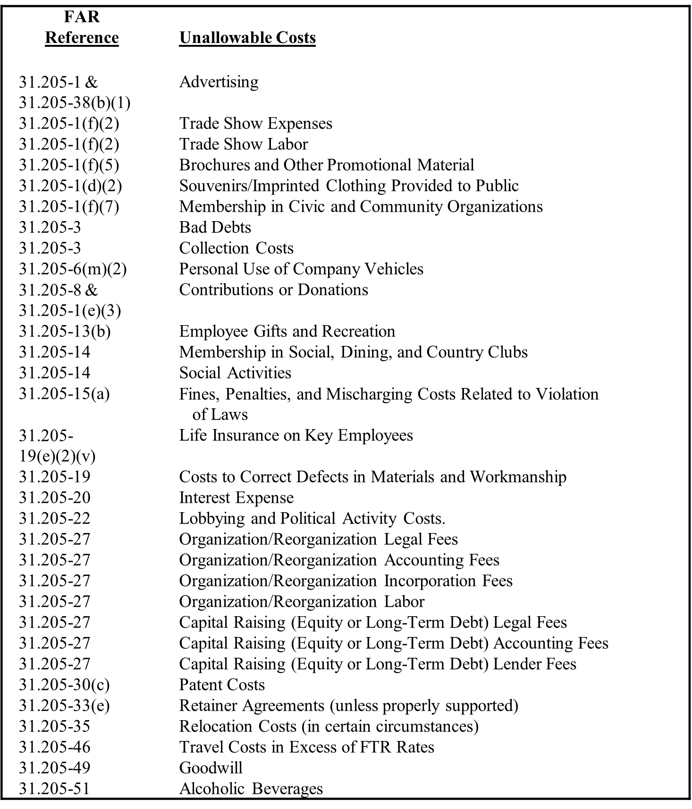
List of Common Unallowable Costs
Notes:
The table on the following page lists expenses that generally are ineligible for cost reimbursement on Government contracts (either as direct or indirect costs). The list is not all inclusive, but it identifies many types of costs commonly incurred by engineering consultants.
Vehicle Costs
In cases where transportation costs and consultant-owned or -leased vehicles are involved, only the portion of mileage incurred in connection with company business are allowable; accordingly, engineering consultants are encouraged to maintain mileage logs. Auto lease payments incurred without a documented business purpose do not meet the criteria contained in FAR 31.206-46(d); therefore, these costs are unallowable in full. Related costs such as insurance, gasoline, and car repair also would be unallowable. Extra scrutiny should be applied to costs associated with luxury vehicles.
***The applicable portion of any income, rebate, allowance or other credit relating to any allowable cost and received by or accruing to the contractor shall be credited to the Government either as a cost reduction or by cash refund. So, what is your state’s process?

Slide 31
For more information
Kadian Hollenquest
9500 Wynlakes Place
Montgomery, AL 36117
334-274-6349 or Kadian.Hollenquest@dot.gov

