Slide 1
Audit Results –
Traditional and Agile Auditing

Slide 2




___________________________________________________________________________________________________________________________ s
Bill Pace
Bachelor of Science in Accounting, Florida State University
Prior roles at Coulter Electronics, Inc., Florida Auditor General, FDOT OIG, Quantum Consulting LLC, MBT Forensic CPAs, and Xerox Business Services
Current Role as Deputy Audit Director for Contracts at FDOT OIG, since 2015
Certifications/Licenses: CPA, Certified Public Manager, Florida Certified Contract Manager
Agile auditing experience: Getting there

Slide 3
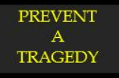




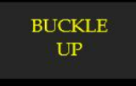
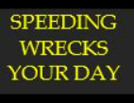
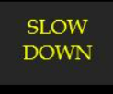

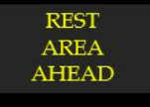


Safety Message

Slide 4

Introduction
FDOT Office of Inspector General
Traditional Audit vs. Agile Audit Delivery
Audit Results & Lessons Learned
Special Review: Contractor Prequalification Process

Slide 5
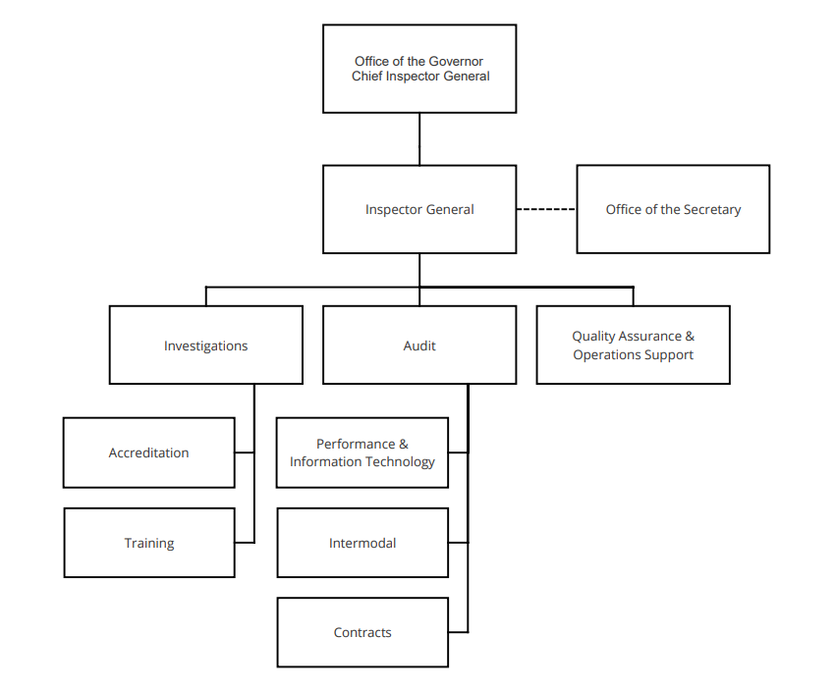

Slide 6
What does an Inspector General do?
Central point for coordination of responsibility for activities that promote -- accountability, integrity, and efficiency in government.
Conduct, supervise, or coordinate other activities carried out or financed by that state agency for the purpose of promoting economy and efficiency in the administration of, or preventing and detecting fraud and abuse in, its programs and operations.
Regarding fraud, abuses, and deficiencies, keep the agency head informed and recommend corrective action.
Supervise and coordinate audits, investigations, and management reviews.

Slide 7

Contract Audit
Performs audits, examinations, reviews to include agreed upon procedures and special analyses of contracts and agreements between the Department and external entities to ensure costs proposed and charged to the Department by consultants, construction contractors and other external groups are accurate, reasonable and comply with applicable federal and state regulations.

Slide 8
Intermodal Audit
Performs audits and reviews to determine the allowability of costs associated with various activities including agreements between the Department and railroads, authorities, public transportation entities and utilities companies. Engagements related to rail labor additive rates and invoices; transportation, expressway, and bridge authorities; seaport, airport and transit grants; utility relocation costs; grant audits; indirect cost allocation and fringe benefit rates.

Slide 9
Performance and Information Technology Audit
Conducts performance audits and management reviews of organizational units, programs, activities and functions in accordance with applicable professional standards. The work of Performance and Information Technology Audit consists of performance audits, financial audits, performance measures assessment, risk assessment, information technology audits, computer forensic reviews, and data mining.

Slide 10
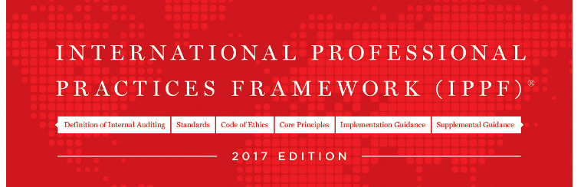
Florida Statutes 20.055 - Agency Inspectors General
Such audits shall be conducted in accordance with the current International Standards for the Professional Practice of Internal Auditing as published by the Institute of Internal Auditors or, where appropriate, in accordance with generally accepted governmental auditing standards. All audit reports issued by internal audit staff shall include a statement that the audit was conducted pursuant to the appropriate standards.
findings, conclusions, or recommendations of a final report of a state agency inspector general, who are the subject of the audit or investigation, and who do not have or are not currently afforded an existing right to an independent review process.
Such audits shall be conducted in accordance with the current International Standards for the Professional Practice of Internal Auditing as published by the Institute of Internal Auditors, Inc., or, where appropriate, in accordance with generally accepted governmental auditing standards. All audit reports issued by internal audit staff shall include a statement that the audit was conducted pursuant to the appropriate standards.

Slide 11

Florida Statutes 20.055 - Agency Inspectors General
“Individuals substantially affected” means natural persons who have established a real and sufficiently immediate injury in fact due to the findings, conclusions, or recommendations of a final report of a state agency inspector general, who are the subject of the audit or investigation, and who do not have or are not currently afforded an existing right to an independent review process.

Slide 12
Florida Statutes 20.055 - Agency Inspectors General
At the conclusion of an audit in which the subject of the audit is a specific entity contracting with the state or an individual substantially affected, if the audit is not confidential or otherwise exempt from disclosure by law, the inspector general shall, consistent with s. 119.07(1), submit the findings to the entity contracting with the state or the individual substantially affected, who shall be advised in writing that they may submit a written response within 20 working days after receipt of the findings. The response and the inspector general’s rebuttal to the response, if any, must be included in the final audit report.d a real and sufficiently immediate injury in fact due to the findings, conclusions, or standards. All audit reports issued by internal audit staff shall include a statement that the audit was conducted pursuant to the appropriate standards.

Slide 13
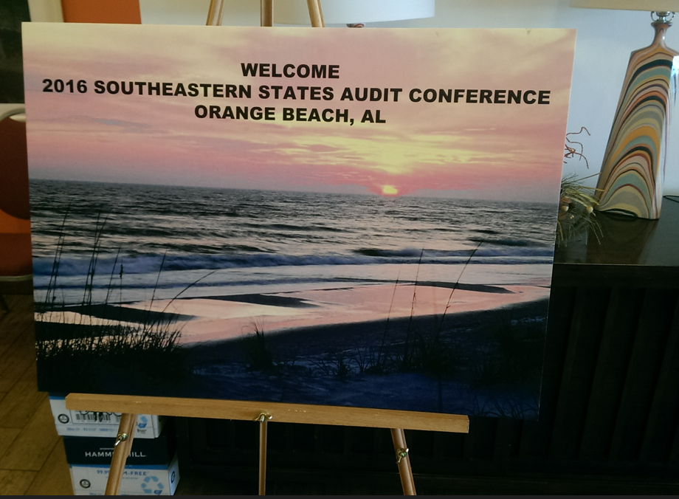

Slide 14
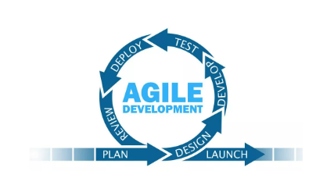
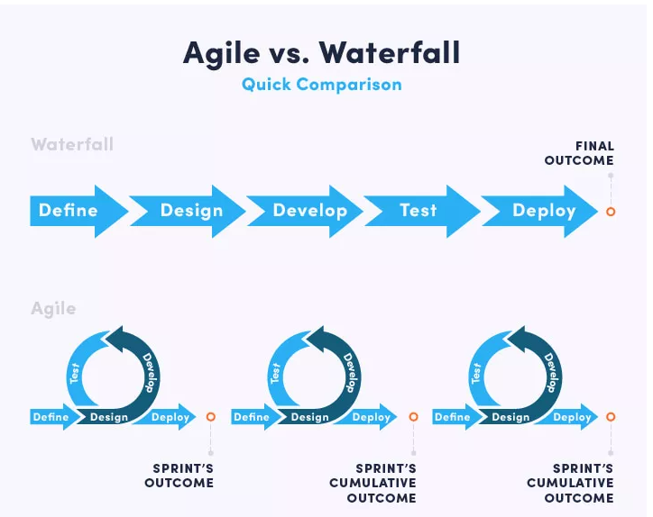
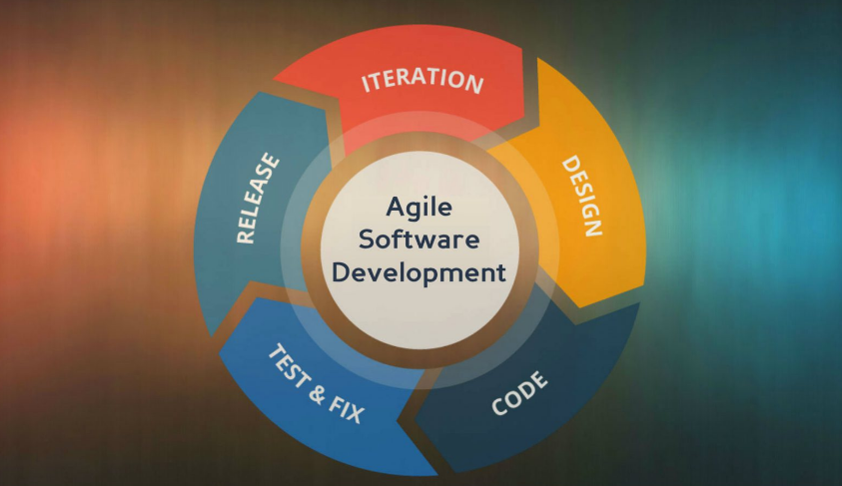
(Software) Agile Methodology

Slide 15
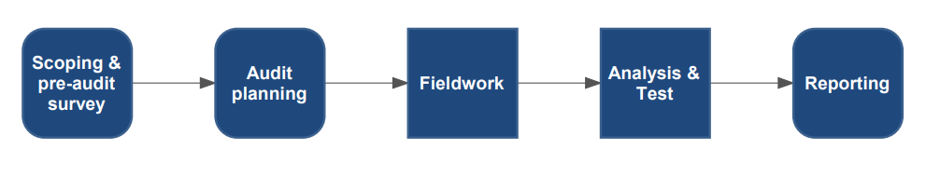
Traditional Audit Delivery
Source: International Journal of Smart Business and Technology, February 2021

Slide 16
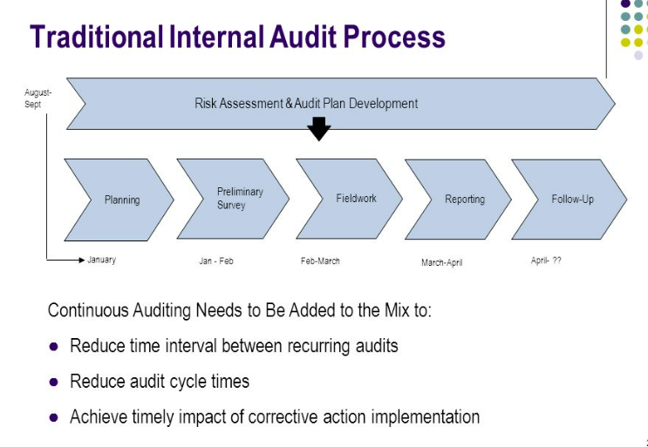

Slide 17
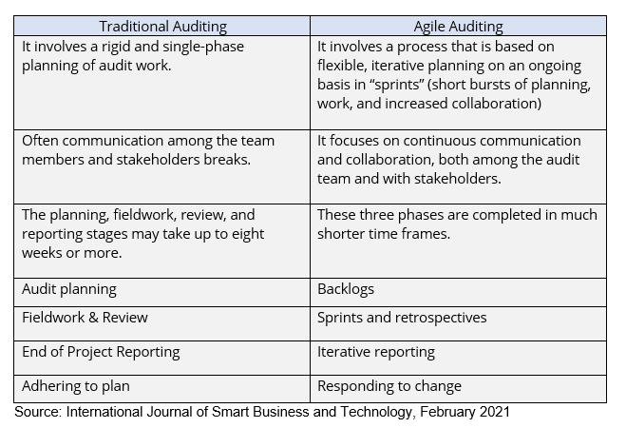

Slide 18

Agile Auditing
  Short cycles and continuous evaluation are essential in applying the Agile method.
  For more frequent interactions with the auditee, you also need more courage as an Internal Audit Function.
  Although the implementation differs, an audit remains an audit, in other words it remains important to continue to pay attention to formal documentation and the IIA Standards.
  Use experts who can translate between the Agile principles and internal audit.
  Source: KPMP, Agile Internal Audit, October 2020

Slide 19
Agile Auditing
  Short cycles and continuous evaluation are essential in applying the Agile method.
  For more frequent interactions with the auditee, you also need more courage as an Internal Audit Function.
  Although the implementation differs, an audit remains an audit, in other words it remains important to continue to pay attention to formal documentation and the IIA Standards.
  Use experts who can translate between the Agile principles and internal audit.
  Source: KPMP, Agile Internal Audit, October 2020

Slide 20
Agile Auditing
  Short cycles and continuous evaluation are essential in applying the Agile method.
  For more frequent interactions with the auditee, you also need more courage as an Internal Audit Function.
  Although the implementation differs, an audit remains an audit, in other words it remains important to continue to pay attention to formal documentation and the IIA Standards.
  Use experts who can translate between the Agile principles and internal audit.
  Source: KPMP, Agile Internal Audit, October 2020

Slide 21
Agile Auditing
  Short cycles and continuous evaluation are essential in applying the Agile method.
  For more frequent interactions with the auditee, you also need more courage as an Internal Audit Function.
  Although the implementation differs, an audit remains an audit, in other words it remains important to continue to pay attention to formal documentation and the IIA Standards.
  Use experts who can translate between the Agile principles and internal audit.
  Source: KPMP, Agile Internal Audit, October 2020

Slide 22
Agile Auditing
Go Small
Limit Work in Process
Evaluate Progress & Share Results
Make it Your Own

Slide 23


Slide 24
Audit Results
Traditional:
Push-Button Contracts
Errors and Omissions Consultant Cost Classification
Agile:
Duplicate Payments to CEI Firms
Audit of Direct Labor Cost Transfers
Special Review:
Construction Contractor Prequalification Process

Slide 25
Push-Button Contracts
What is a Push-Button contract?
  State departments of transportation have been using Indefinite Delivery Indefinite Quantity (IDIQ) contracting for decades under a wide variety of names including Push-Button contracts, Job Order contracts, On-call contracts, Master contracts, Stand-by contracts, Framework contracts, Term Agreements, Delivery Order contracts, and Task Order contracts. IDIQ contracts establish a defined scope of work to be completed by the contractor and include established unit cost prices for pre-determined work items.

Slide 26
Push-Button Contracts
What is a Push-Button contract?
  When establishing a Push-Button contract, the Department identifies a need for a deliverable (defined scope); however, the Department does not know when, where (indefinite delivery), or the quantity of work required (indefinite quantity). The work required to be completed by the contractor is pursuant to the issuance of work documents (task work orders).

Slide 27
Push-Button Contracts
Risk:
  The identified risk was that the Department may not be utilizing Push-Button contracts for their intended purposes for supporting operations and alleviating safety issues.
Objective:
  To determine if:
    the scope of Push-Button contracts is being written in accordance with available Department criteria regarding the purpose of these contracts; and
    task work orders issued on active Push-Button contracts comply with the original scope of the contract.

Slide 28
Push-Button Contracts
Methodology/Scope:
  reviewed current Department policies and procedures governing Push-Button contracts;
  identified active District Push-Button contracts as of May 29, 2019, utilizing the Office of Construction’s Statewide Construction Dashboard;
  interviewed Central and District Office staff from the Office of Construction, Program Management, Work Program, Traffic Operations, and Contracts Administration; and
  reviewed and tested Push-Button task work orders.

Slide 29
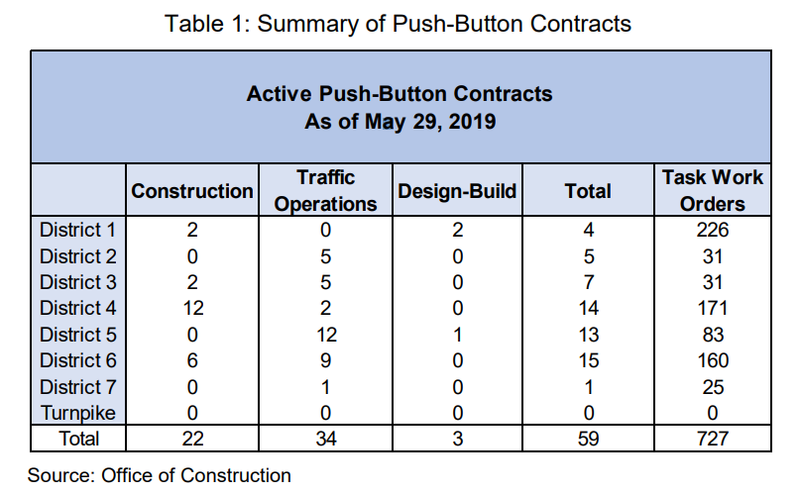

Slide 30
Push-Button Contracts
Results:
  We determined the scopes of Push-Button contracts tested were written in accordance with the Department’s current governance of Push-Button contracts. We also determined task work orders issued on the active Push-Button contracts align with the overall scope of their respective contracts.
  We observed an opportunity exists to enhance the Department’s procedures governing the Push-Button contract process.

Slide 31
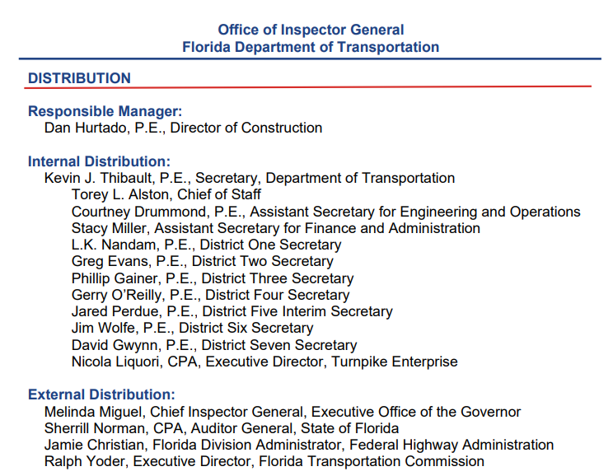

Push-Button Contracts

Slide 32

Push-Button Contracts
After-Action:
  No adverse findings, no required follow-up.

Slide 33
Errors and Omissions - Consultant Cost Classification
What are Errors and Omissions?
The Department defines errors and omissions as “Acts of negligence committed by the Engineer of Record (EOR) in the performance of engineering design service or creative work and acts of negligence committed by Consultant Construction Engineering & Inspection in the performance of construction engineering inspection services.”
Premium costs are additional costs of a contract change that would not have been incurred if the work had been included in the original contract.

Slide 34
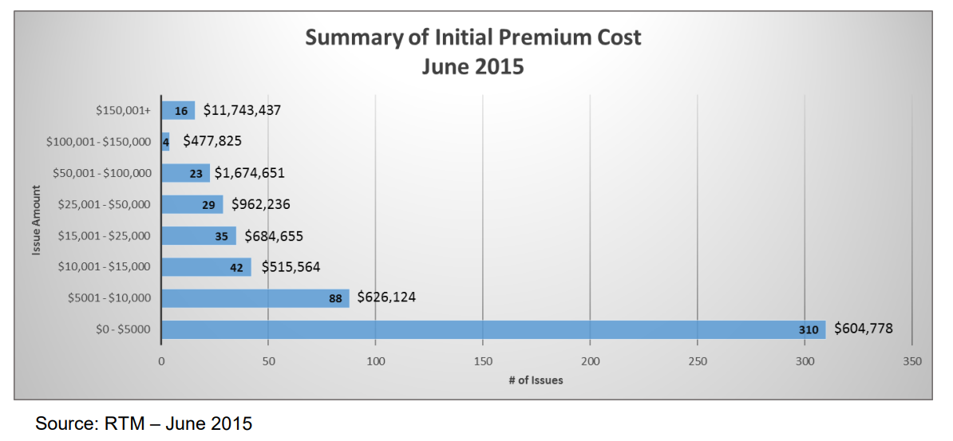

Slide 35
Errors and Omissions - Consultant Cost Classification
Risk:
  Identified risk from an earlier cognizant review.
Objective:
  To determine:
    how A&E firms classified and recorded E&O claim settlement payments in their accounting system; and
    If the settlement payments were included in the firms’ audited overhead.

Slide 36
Errors and Omissions - Consultant Cost Classification
Methodology/Scope:
  E&O claim settlement payments to the Department from January 1, 2016, to October 1, 2019;
  Selected sample (next slide);
  Requested general account detail from A/E firms; and
  Held working conference with the A/E firms to review the accounting classification and recording in the accounting system.

Slide 37

Errors and Omissions Consultant Cost Classification
Sample selection:
  Source: FDOT Resolution Tracking Module:
  86 E&O claim settlement payments totaling $1,315,982 from 41 A/E firms,
  Sampled 26 of the 86 payments totaling $925,598,
  Eight A/E firms

Slide 38
Errors and Omissions - Consultant Cost Classification
Results:
  Eight of the 26 payments, totaling $207,862, or 22 percent, were included in the firms’ overhead rate calculation.
  The audit did not determine the impact of the inclusion of these costs in the Department’s approved audited overhead rate because testing was limited to payments made to the Department.
A/E firm responses:
    Five of the eight A/E firms concurred or had no comment.

Slide 39
Errors and Omissions - Consultant Cost Classification
After-Action:
  Procurement Office created a link on their internet site to the audit to highlight for the consulting industry the errors and omissions reporting concern.
  OIG added a step to the cognizant review engagement program.

Slide 40


Slide 41

Duplicate CEI Payments
Risk/Objective:
  To determine if invoiced “other direct expenses” were excluded from the firm’s [FDOT] direct expense or A/E firm’s overhead rate.

Slide 42
Duplicate CEI Payments
Sample Selection:
Identified CEI contracts with invoices in 2019 and 2020 which contain reimbursable other direct expenses.
Judgmentally selected one contract from each District (8 contracts).
Test sample included five contracts that had reimbursable rent and utilities expenses.
Test sample included three contracts that had reimbursable equipment expenses.

Slide 43
Duplicate CEI Payments
Methodology:
Obtained profession services agreements, amendments, and method of compensation schedules;
Held entrance and working conferences with A/E Firms;
Obtained project job costs and general ledger detail;
Reviewed how incurred costs were classified and recorded;
Held iterative working conferences with Department management; and
During the audit decision was made to issuing individual audit reports vs. one report.

Slide 44
Duplicate CEI Payments
Tentative Results:
  Four A/E firm were found in compliance with the FARs and Department direct expense rate policies;
  One firm has reimbursed the Department for office rent costs not incurred;
  Two firms have developed issues for non-disclosure of related-party transactions; and
  One firm has a developed issue regarding allocation of equipment costs to projects and non-disclosure of related-party transactions.

Slide 46

Audit of Direct Labor Cost Credits
Risks:
Past post-audits have noted transfer of direct labor costs after the timesheet has been approved by the supervisor.
For cognizant reviews, OIG has incorporated new questions into a questionnaire sent to CPA firm performing the overhead audit.

Slide 47
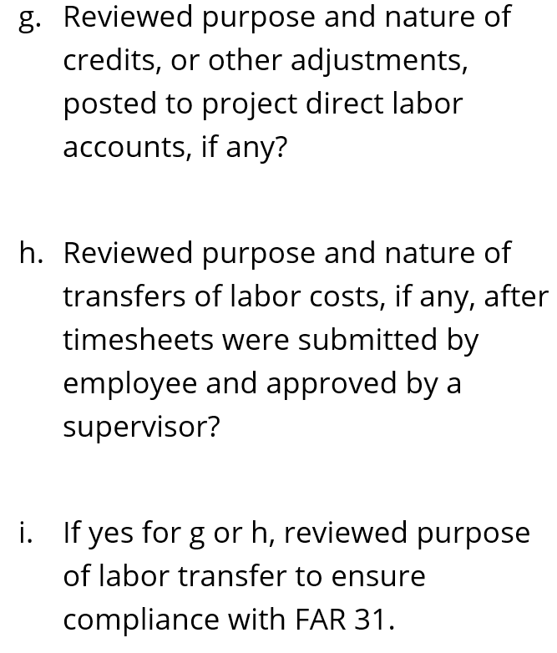
Audit of Direct Labor Cost Credits

Slide 48
Audit of Direct Labor Cost Credits
Objective:
  Determine if direct labor cost credits (transfers) are supported and comply with governing directives.
  Determine if transferred direct labor costs are properly accounted on the A/E firm’s invoices to the Department.

Slide 49
Audit of Direct Labor Cost Credits
Sample Selection:
  Active contracts as of January 3, 2022 (design included).
  Excluded A/E firm’s providing services with annual billings less than $500,000.
  586 contracts, $2,553,557,987, 106 A/E firms.
  Contracts were divided - top 30% and 70%.

Slide 50
Audit of Direct Labor Cost Credits
Methodology:
  Agile sprint methodology incorporated into audit plan – one firm at a time.
  Obtained professional services agreements and amendments.
  Obtained detail job costs / labor distribution report.
  Held working conference with A/E firms

Slide 51
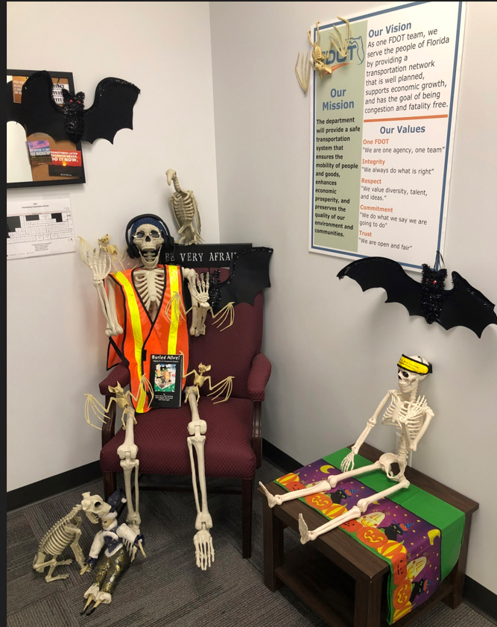
A/E Firm Direct Labor Cost Transfers (Design Contracts)
Interim Results:
  First firm had 5 labor cost transfers – report issued, no adverse findings
  Second firm had 463 labor cost transfers – tentative issue regarding date of the accounting transfer
  Third firm 181 labor cost transfer – A/E firm’s explanations are currently under review

Slide 52


Slide 53
Contractor Prequalification Process
Objective:
  Determine if the maximum capacity rating (MCR) reflects current best management practices.
Methodology:
  Interviewed internal and other State DOTs
  Analyzed 13 other state’s DOT prequalification processes
  Reviewed contractor approved applications

Slide 54
Contractor Prequalification Process
Results:
  We found the Department’s contractor prequalification process appears to be working as intended and no significant adjustments were identified at this time which would have a material impact to the formula used to calculate a contractor’s MCR.
  In addition, the characteristics of the prequalification factors used by the Department are comparable to other states.

Slide 55

Contractor Prequalification Process
Observation:
  The Department could enhance its verification of the integrity of the project information reported on the contractor’s prequalification application.

Slide 56
Contractor Prequalification Process
Observation:
Verification of the integrity of the project information submitted by contractors can be enhanced by requesting and using supplementary information prepared in conjunction with the contractors’ financial statements.
The supplementary information includes all projects completed during the year and all contracts in progress as of the date of the Balance Sheet. The supplementary information also supports the Balance Sheet amounts reported for:
    Cost and Estimated earnings in Excess of Billings in Current Assets
    Billings in Excess of Cost and Estimated Earnings in Current Liabilities.

Slide 57
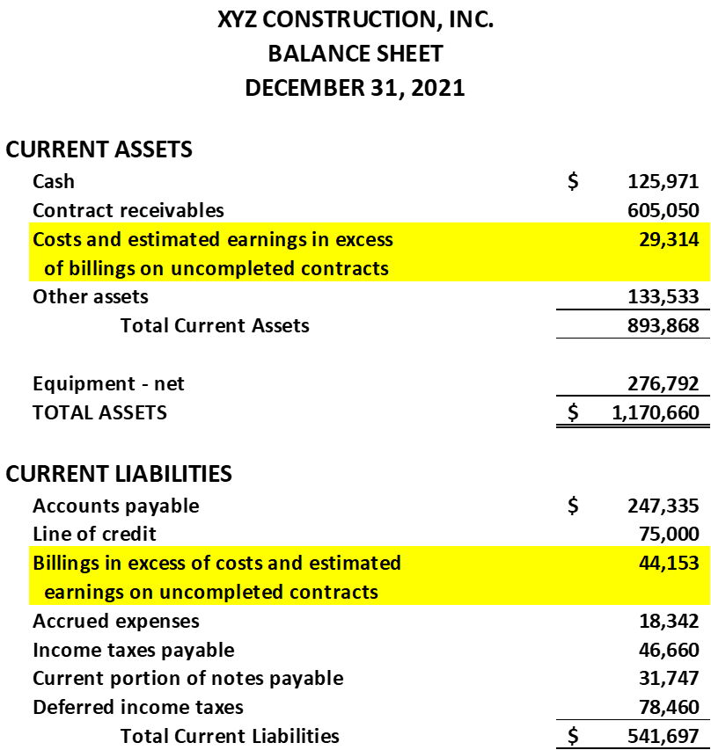

Slide 59
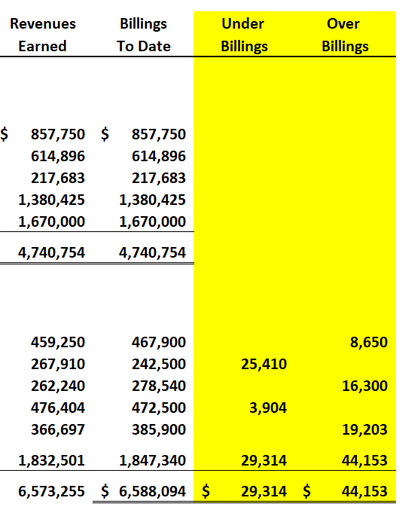

Slide 60
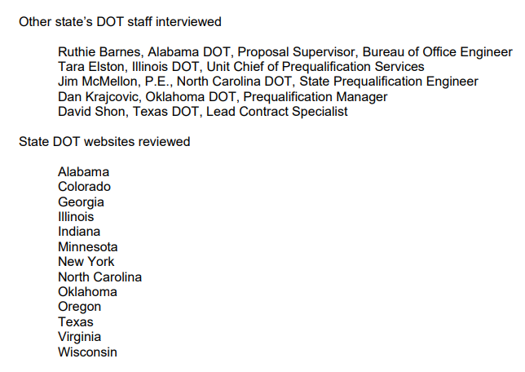
Contractor Prequalification Process

Slide 61

Thank you!
For more information about specific reports please go to FDOT.gov/IG.
Contact information:
Bill.Pace@dot.state.fl.us
850-410-5507 (office)

